Slide 1
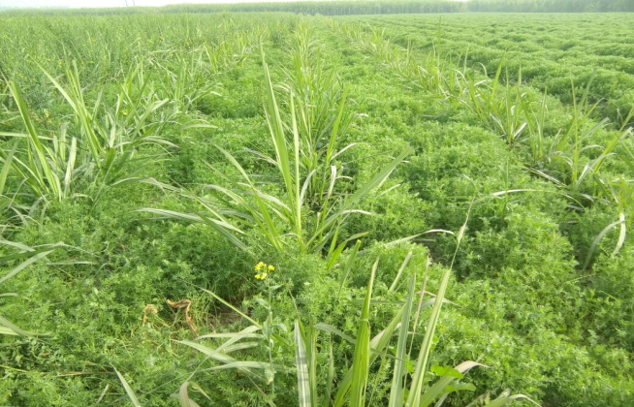
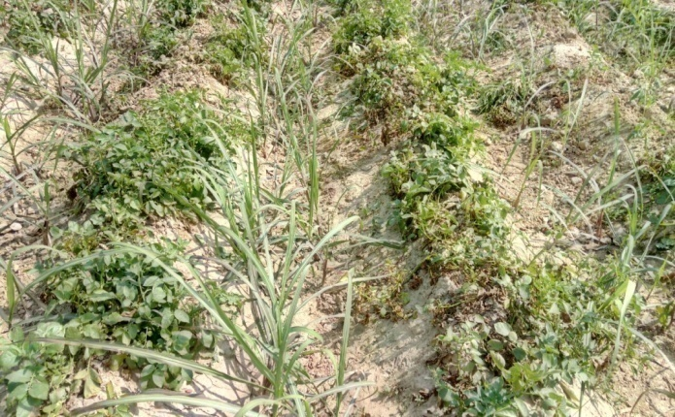
Sugarcane Status & Developmental Programmes
Dr. A.L.Waghmare
Director
DIRECTORATE OF SUGARCANE DEVELOPMENT
Govt. of India, Ministry of Agriculture & Farmers Welfare
Lucknow – 226 024 (U.P.)

Slide 2
Importance
7% share of total value of agriculture output.
About 50 million farmers and 0.4 million skilled and unskilled workers are engaged in cultivation of sugarcane and sugar industries & its allied industries.
Provides raw materials for the second largest agro-based industry after textile.
Sugar industry playing an important role in socio economic development, mobilizing rural resources, generating employments, improvement farm income etc.
Cultivated in about 2.5% of India’s gross cropped area.

Slide 3
 | Area (Million ha) | Production (Million tonnes) | Yield (Tonnes/ha)
World | 26.52 | 1877.10 | 70.77
Brazil | 9.83 | 739.27 | 75.17
India | 5.06 | 341.20 | 67.43
India | 5.06 | 341.20 | 67.43
U.P | 2.18 | 134.87 | 61.80
MS | 0.98 | 78.32 | 79.78
Tropical region
MS, Tamil Nadu, Gujarat,
Karnataka, AP, Odisha and
part of M.P
45% of the country area
55% of the country prodn.
83 t/ha productivity
Sub-tropical region
U.P., UK, Haryana, Punjab,
Bihar,West Bengal and North East states
55% of the country area
45% of the country production
65t/ha productivity

Slide 4
Sugarcane Area : % share

Slide 5
Sugarcane Production: % share

Slide 6
State-wise Yield (tonnes/ha)

Slide 7
Top 20 Districts of Sugarcane (U.P.)
S. N. | District | Area (ha) | Production (Tonnes) | Yield (Tonnes/ha)
1. | Kheri | 256442 | 16417465 | 64.02
2. | Bijnor | 204720 | 12947450 | 63.24
3. | Muzzaffarpur | 169143 | 12353560 | 73.04
4. | Sitapur | 145573 | 9501548 | 65.27
5. | Meerut | 126186 | 9348390 | 74.08
6. | Saharanpur | 126663 | 8106889 | 64.00
7. | Bareilly | 92598 | 5750272 | 62.10
8. | Bagpat | 73432 | 5529571 | 75.30
9. | Amroha | 75952 | 5231127 | 68.87
10. | Pilibhit | 76555 | 4969494 | 64.91
11. | Shamli | 63041 | 4837457 | 76.73
12. | Kushinagar | 76786 | 4593823 | 59.83
13. | Gonda | 77829 | 4340681 | 55.77
14. | Bulandshahar | 48675 | 3108453 | 63.86
15. | Moradabad | 47574 | 3052007 | 64.15
16. | Shahjahanpur | 44784 | 2894560 | 64.63
17. | Hapur | 36906 | 2448810 | 66.35
18. | Basti | 39188 | 2408142 | 61.45
19. | Balrampur | 43896 | 2235007 | 50.92
20. | Hardoi | 36869 | 2231610 | 60.53
 | State | 2196011 | 142213362 | 64.76

Slide 8
Uttar Pradesh
 | 2014-15 | 2015-16 | 2016-17 | 2017-18
Area (Lakh ha) | 21.41 | 21.69 | 21.60 * | 22.65**
Production (Lakh tonnes) | 1330.60 | 1453.90 | 1337.04*
Yield (tonnes/ha) | 62.16 | 67.03 | 61.90*
Sugar Production (Lakh tonnes) | 71.02 | 68.41 | 87.73**
Sugar Recovery (%) | 9.54 | 10.62 | 10.61**
*- III rd Advance estimates, E & S
**- Cane Commissioner office, U.P.

Slide 9
State-wise sugar Recovery (Ave. of 2011-12 to 2015-16)

Slide 10
Varietal coverage in Uttar Pradesh during 2014-15 to 2016-17

Slide 11
Area coverage of major varieties in Uttar Pradesh

Slide 12
SUGARCANE DEVELOPMENT PROGRAMMES
October 2000, the Crop oriented CSS implemented in different States subsumed with MMMA.
The main components continued to remain same with the flexibility to incorporate new components as per the requirement of the state.
MMMA is continued till 2013-14.
From 2014-15, New scheme NFSM- Commercial Crop (Sugarcane) is under implementation.

Slide 13
Allocation under Centrally Sponsored Scheme of NFSM-Commercial crops (Sugarcane) 2017-18
S.No. | State | Rs. In Lakh
 |  | Central Share | State Share | Total
1 | Andhra Pradesh | 12.11 | 8.07 | 20.18
2 | Gujarat | 15.38 | 10.25 | 25.63
3 | Haryana | 19.76 | 13.17 | 32.93
4 | Karnataka | 29.57 | 19.71 | 49.28
5 | Madhya Pradesh | 19.78 | 13.19 | 32.97
6 | Maharashtra | 188.99 | 125.99 | 314.98
7 | Tamil Nadu | 29.65 | 19.77 | 49.42
8 | Telangana | 3.30 | 2.20 | 5.50
9 | Orissa | 21.99 | 14.66 | 36.65
8 | Uttar Pradesh | 294.45 | 196.30 | 490.75
9 | Punjab | 15.00 | 10.00 | 25.00
10 | Uttrakhand | 19.80 | 2.20 | 22.00
11 | Bihar | 84.00 | 56.00 | 140.00
 | Total | 753.78 | 491.52 | 1245.30

Slide 14
Implementing agencies
SDA- Andhra Pradesh, Gujarat, Haryana, Karnataka,
Madhya Pradesh, Maharashtra, Tamil Nadu, Uttar
Pradesh, Odisha, Punjab,Uttarakhand, Bihar &
Telangana.
DAC&FW- DSD, Lucknow (nodal office)
ICAR-IISR, KVKs, SAUs, Cooperatives, NGOs, Private
Sector etc.
Fund sharing pattern : 60% GOI: 40% State

Slide 15
. Components and pattern of assistance under
NFSM- Commercial crops ( Sugarcane)
1 | Demonstration on intercropping of pulses, cereals and oilseeds with sugarcane | Rs. 8000 per ha | ICAR/ SAUs/ KVK/ NGOs/ Cooperatives/ State Deptt. of Agriculture
2 | Seed Production
a. | Assistance in Breeder Seed Production | Rs. 40000 per ha | SAU,s/ ICAR and Sugarcane Research Institute, sugar factories,
b | Production of tissue culture raised plantlets/ seedlings | Rs. 3.5 per seedlings | Sugarcane Institutions, Sugar factories, NGOs.
3 | Strengthening of bio agent and tissue culture lab | Rs. 75 lakhs per lab | Sugar factories/ SAU’s/ ICAR/ Sugarcane Resh. Instt. Etc.

Slide 16
4 | Training |  | Sugar factories/ SAU’s/ ICAR/ Sugarcane Resh. Instt. Etc.
a. | National Level Trainings | 50000 per training | IISR, SBI, VSI, UPCSR, etc. State government KVKs, NGO etc.
b. | State level training | 40000 per training
5 | Monitoring, evaluation & electronic print media. |  | DOSD, Lucknow

Slide 17
NFSM-CC (Sugarcane)-UP-2017-18
Districts covered(24)
Saharanpur, Muzzaffarnagar, Shamli, Meerut, Bagpat, Hapur, Ghaziabad, Bulandsahar, Moradabad, Bijnaur, Rampur, J.P.Nagar, Bareily, Pilibhit, Shahjahanpur, Sitapur, Lakhimpur, Hardoi, Bahraich, Gonda, Balrampur, Kushinagar, Basti and Faizabad.

Slide 18
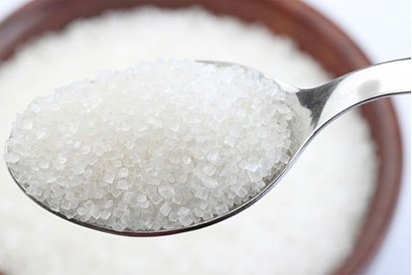
THANK YOU

